Slide 1
ALTAR GUILD PROJECT BY TEAM BETTER HAPPO

Slide 2
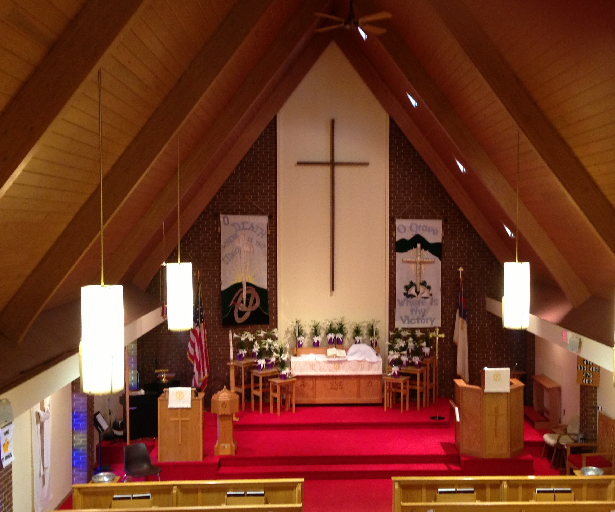
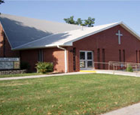
Introduction
Hope Lutheran Church
Church year
Church interior:
Paraments
Different Colors for Different Seasons
Banners
Change with season and holidays
Committee of 10 members

Slide 3

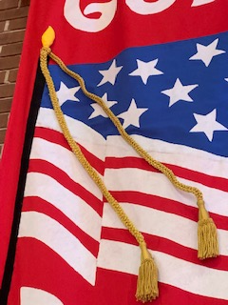
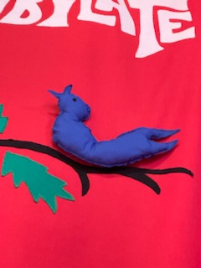
Things done by Altar guild
There are many things that need to be identified to celebrate the festivals at church.
What is the date of particular festival?
Identify the color of the parament for each week of the church year
Identify banners associated with each season
Identify whether the banners are front banners, side banners or aisle banners
Identify banner pairs (2 banners that are always hung together in the front)
Identify any special preparations for each banner
Identify where the banner is stored
When is a particular banner used last time?
Who are responsible for that particular festival?
Identify Guild members and their contact information
What are the things to be done by the person when assigned to the festival?
Identify which months the guild members are assigned to work

Slide 4
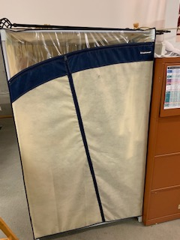
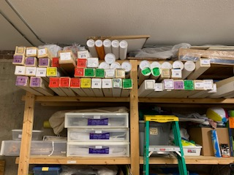
Introduction to the problem
They should refer documents to identify the festival dates and parament colors manually.
There is no track of when is the banner used last time and how many times it has been used.
Banners are color coded and numbered, but not all are associated with seasons.
No good coordination of information.
Banner notebook stored in the basement with banners, whereas schedule and contact information is located upstairs near sanctuary which involves a lot of time and effort.

Slide 5
Our solution to the problem
Everything is made available on the website.
All the information can be identified from the mobile or desktop.
Can identify festival dates, parament color to be used for that particular events and what are current and next events from website easily.
All the banners are available on the website sorted by the seasons.
Responsible members for each month will be displayed on the website.
Every year church calendar is automatically generated.
Can track the usage of the banner like how many times is has been used and when was it last used.

Slide 6
Layouts

Slide 7
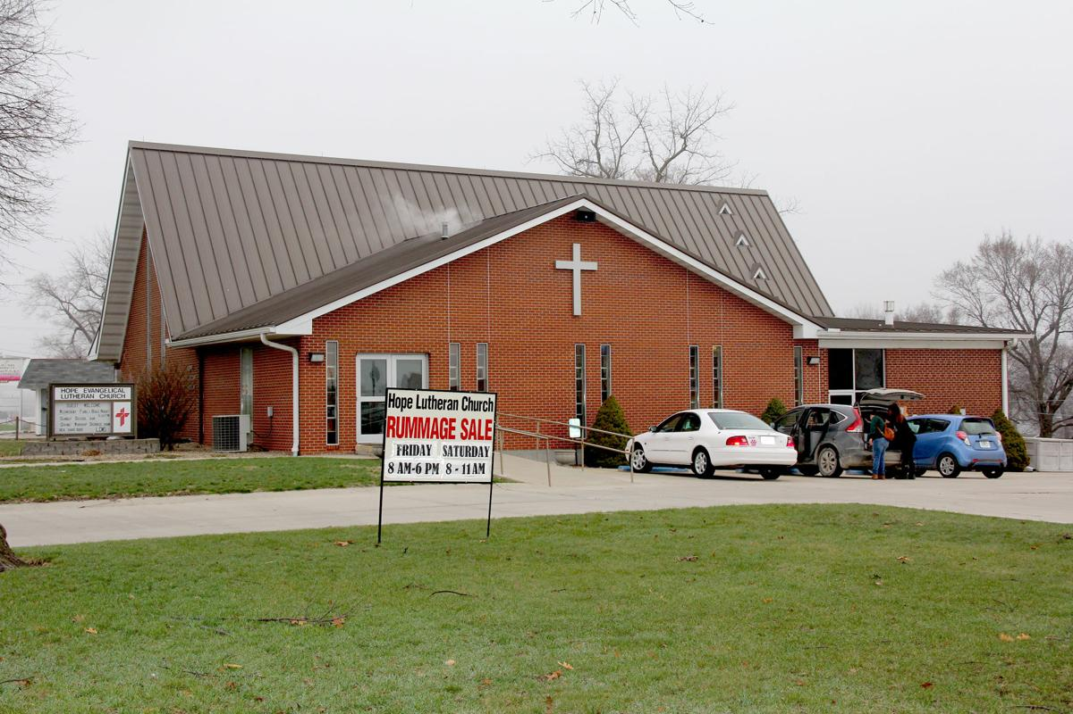
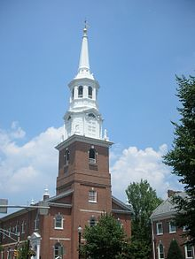
ALTAR GUILD PROJECT
HOPE LUTHERAN CHURCH
HOLY TRINITY LUTHERAN CHURCH
SELECT YOUR CHURCH

Slide 8
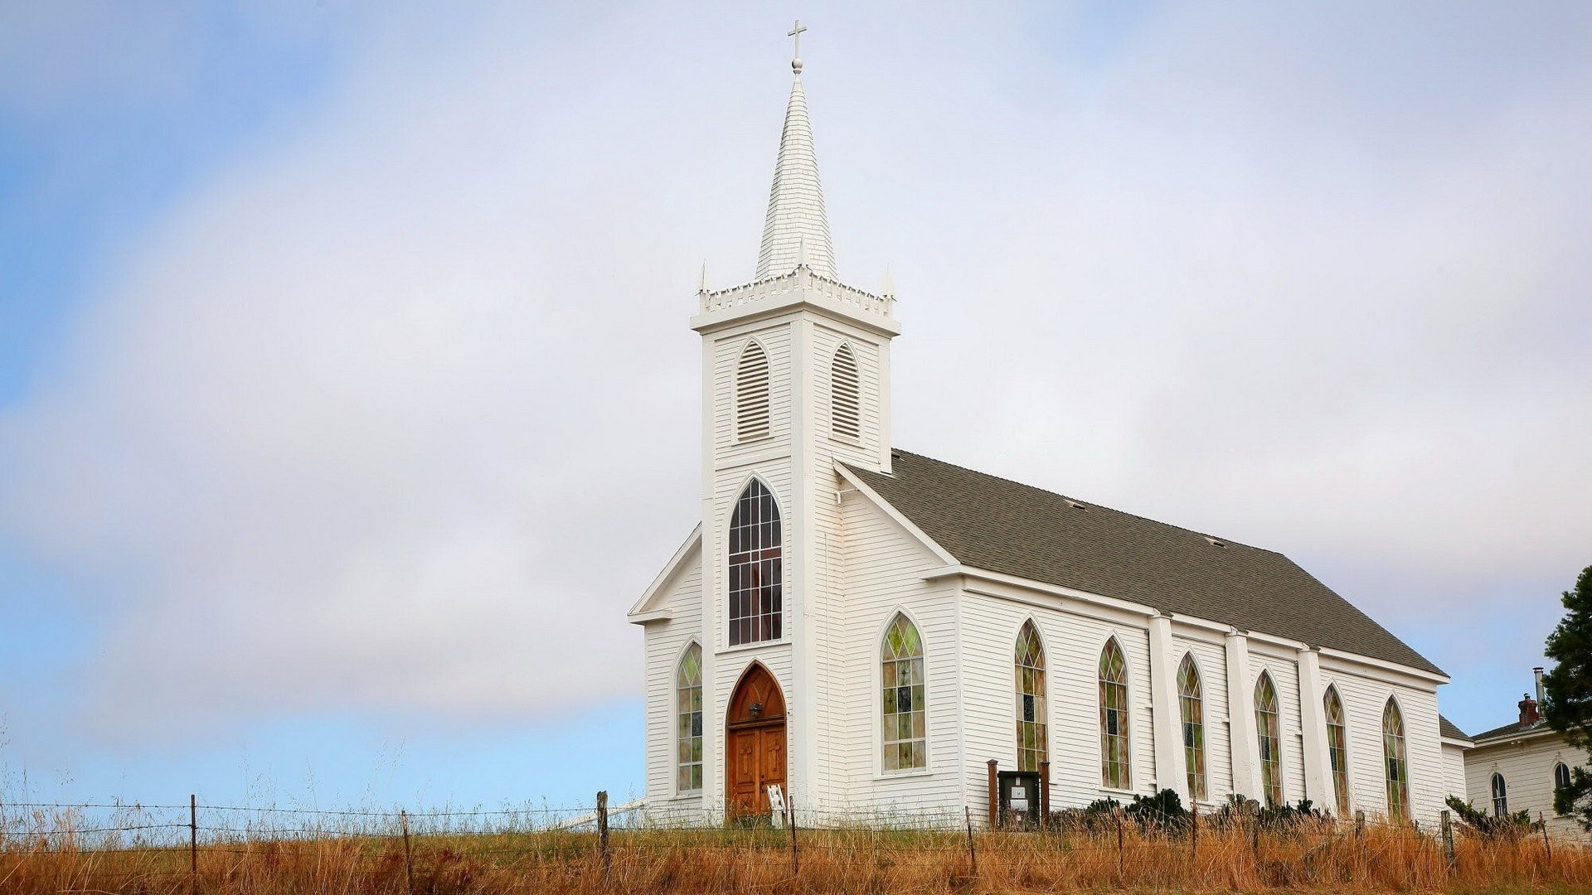
ALTAR GUILD
USERNAME
PASSWORD
LOGIN

Slide 9
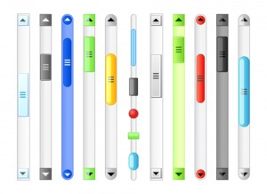
HOME
ALL SEASONS
MEMEBERS INFO
ADMIN PAGE
CURRENT FESTIVAL : - NOV 28TH 2019, WHITE CLOTH
THANKSGIVING
NEXT FESTIVALS :
ADVENT – DEC 23RD 2019, BLUE
CHRISTMAS – DEC 25TH 2019, WHITE
SEASONS:
ADVENT
CHRISTMAS
EPIPHANY
ASH WEDNESDAY
DEC 2-23
DEC 25-30
JAN 6 – 13
MAR 6

Slide 10
RESPONSIBILITIES:
JAN
TWLYA AND MARIE
FEB
KIM AND PHYLLIS
MAR
JEAN AND JAN
APR
PHYLLIS, MARIE AND MARY ANN

Slide 11
HOME
ALL SEASONS
MEMEBERS INFO
ADMIN PAGE
JANUARY :
EPIPHANY
JAN 6- 13
EPIPHANY
JAN 20 – FEB 24
EDIT INFO
ASSIGNED MEMBERS :
TWYLA 222-222-2222 TWYLA@ALTAR.COM
MARIE 333-333-3333 MARIE@ALTAR.COM
RESPOSIBILITIES:
ONE PARAMENT CHANGE
ONE BANNER CHANGE

Slide 12
HOME
ALL SEASONS
MEMEBERS INFO
ADMIN PAGE
CURRENT FESTIVAL : - NOV 28TH 2019, WHITE CLOTH
THANKSGIVING
NEXT FESTIVALS :
ADVENT – DEC 23RD 2019, BLUE
CHRISTMAS – DEC 25TH 2019, WHITE
SEASONS:
ADVENT
CHRISTMAS
EPIPHANY
ASH WEDNESDAY
DEC 2-23
DEC 25-30
JAN 6 – 13
MAR 6

Slide 13


HOME
ALL SEASONS
MEMEBERS INFO
ADMIN PAGE
CHRISTMAS:
PARAMENT COLOR: WHITE
DATE | FESTIVAL | FIRST READING | EPISTLE | GOSPEL
DEC 25 | CHIRSTMAS DAY | IS. 52:7-10 | Heb. 1:1-6(7-12) | John 1:1-14(15-18)
DEC 30

Slide 14
HOME
ALL SEASONS
MEMEBERS INFO
ADMIN PAGE
BANNER HISTORY:
DELETE
IT WAS PRINTED IN THE YEAR 2016
12*16*19
EDIT INFO
WHERE TO FIND:
CLICK ME WHEN YOU USE THIS BANNER
3RD RACK IN THE BASEMENT
TOP SHELF
IN THE BLUE ROUND ROLL
SPECIAL INSTRUCTIONS
BANNER CODE : 3TBR

Slide 15
HOME
ALL SEASONS
MEMEBERS INFO
ADMIN PAGE
BANNER HISTORY:
DELETE
IT WAS PRINTED IN THE YEAR 2016
12*16*19
EDIT INFO
WHERE TO FIND:
CLICK ME WHEN YOU USE THIS BANNER
3RD RACK IN THE BASEMENT
TOP SHELF
IN THE BLUE ROUND ROLL
SPECIAL INSTRUCTIONS
BANNER CODE : 3TBR
Used this banner 3 times
Last used on 07/03/2019

Slide 16

HOME
ALL SEASONS
MEMEBERS INFO
ADMIN PAGE
ALL SEASONS:
ADVENT:
PARAMENT COLOR: BLUE
CHRISTMAS:
PARAMENT COLOR: WHITE

Slide 17

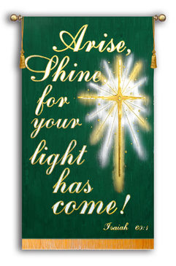
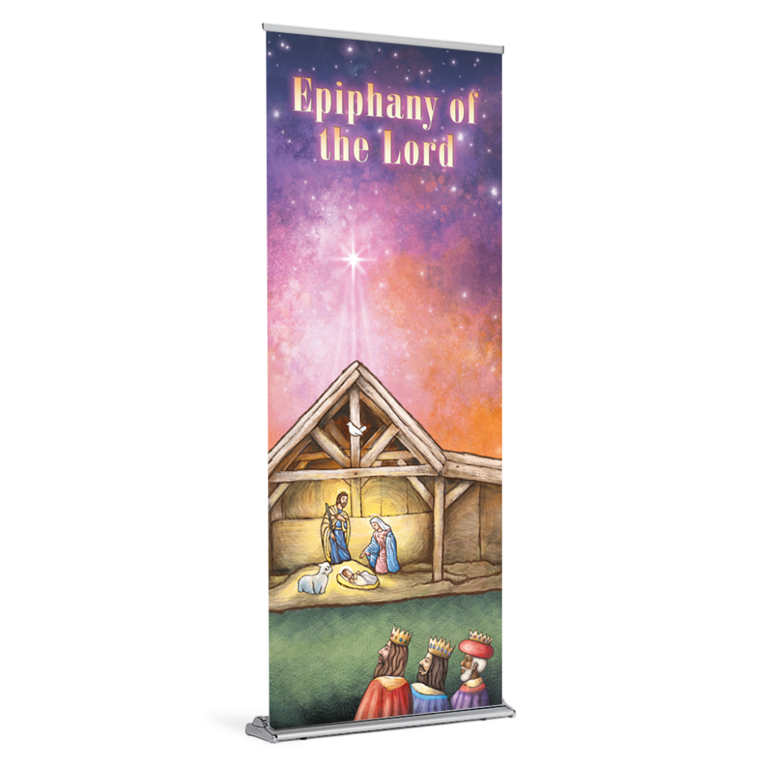
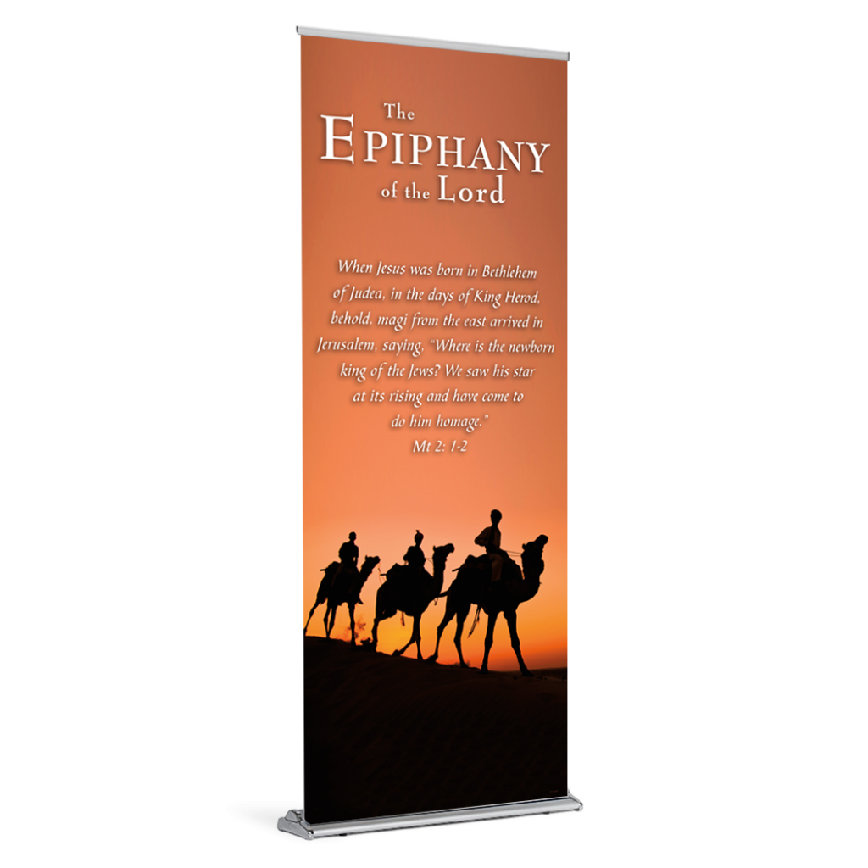
HOME
ALL SEASONS
MEMEBERS INFO
ADMIN PAGE
EPIPHANY:
PARAMENT COLOR: GREEN
EPIPHANY:
PARAMENT COLOR: GREEN

Slide 18
HOME
ALL SEASONS
MEMEBERS INFO
ADMIN PAGE
MEMBERS INFORMATION:
NAME
E- MAIL
PHONE
ADDRESS
1
Dr. Jean Memken
jmemken@mac.com
3098255326
Maryville
X
2
Phyllis
X
3
Pat
X
4
Jan
X
5
Beth
X
6
Twyla
X

Slide 19
HOME
ALL SEASONS
MEMEBERS INFO
ADMIN PAGE
NAME
E- MAIL
PHONE
ADDRESS
7
Kim
X
8
Liz
X
9
Pam
X
10
Marie
X
11
Mary Ann
X
ADD MEMBER

Slide 20
HOME
ALL SEASONS
MEMEBERS INFO
ADMIN PAGE
ADD CHURCH
ADD BANNER
DELETE CHURCH
ADD GUILD MEMBER

Slide 21
Mobile prototype

